Slide 1
Generative Sparse Detection Networks for 3D Single-shot Object Detection (ECCV 2020 Spotlight)
Circle Loss: A Unified Perspective of Pair Similarity Optimization (CVPR 2020 Oral)
VL-BERT: Pre-training of Generic Visual-Linguistic Representations ( ICLR 2020)

Slide 2
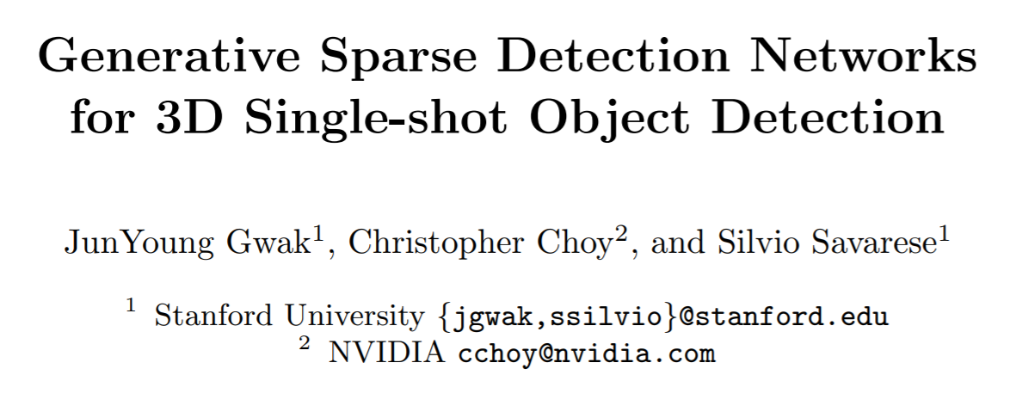

Slide 3
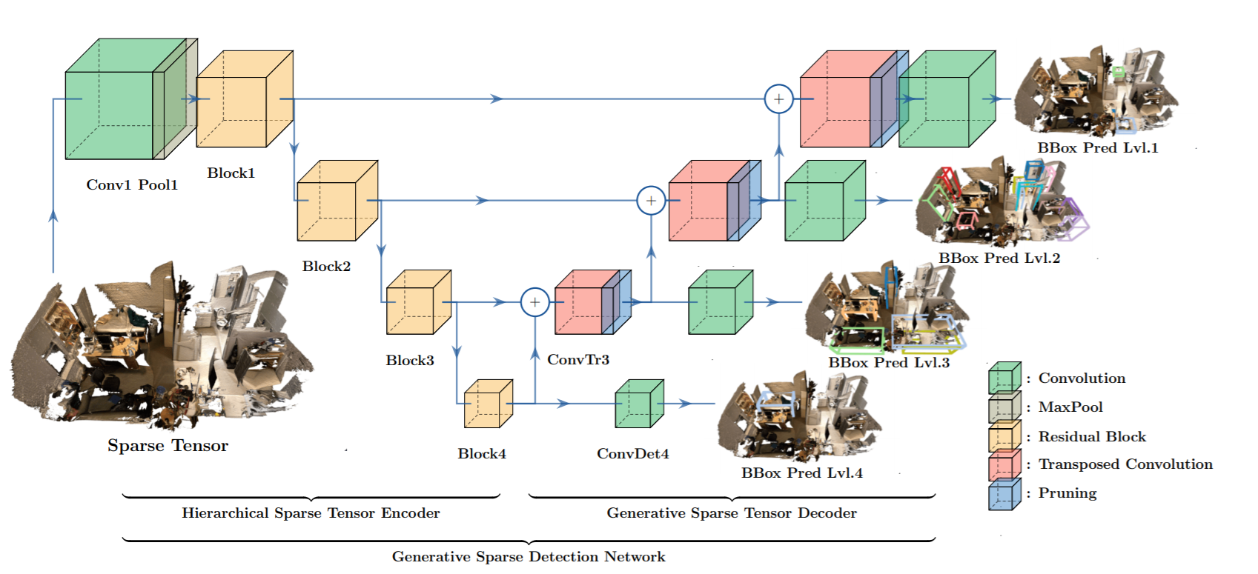

Slide 4
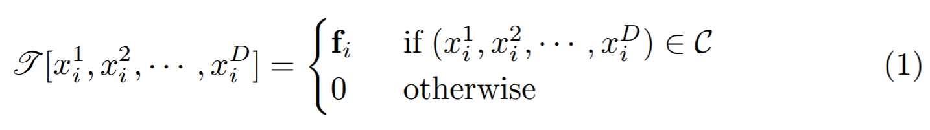
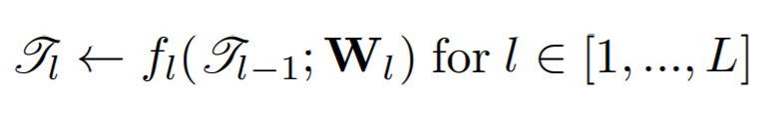
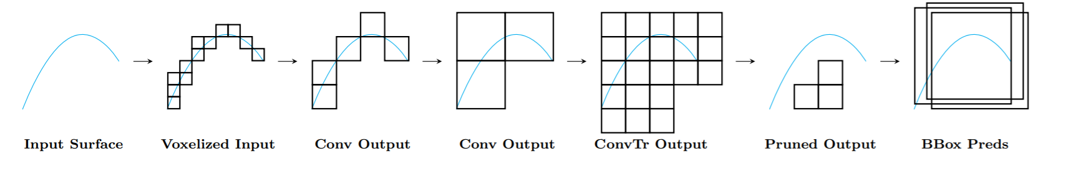
Sparse Tensor
Hierarchical Sparse Tensor Encoder

Slide 5
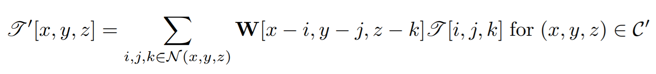
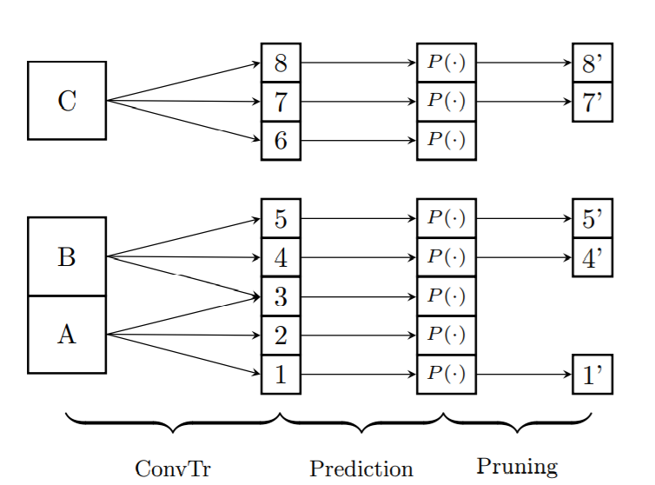
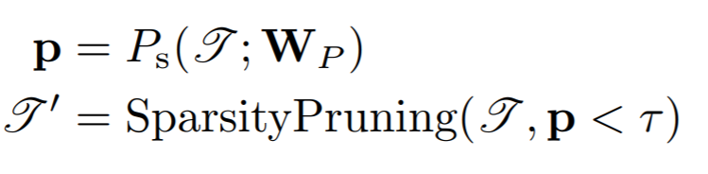
Transposed Convolution and Sparsity Pruning
We denote a function that returns the probability given features at each voxel as Ps(·) and remove all voxels Ps(·) < τ , where τ is the sparsity pruning confidence threshold.

Slide 6
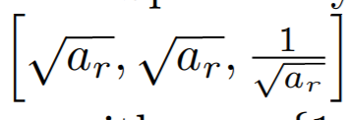
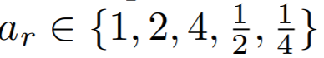
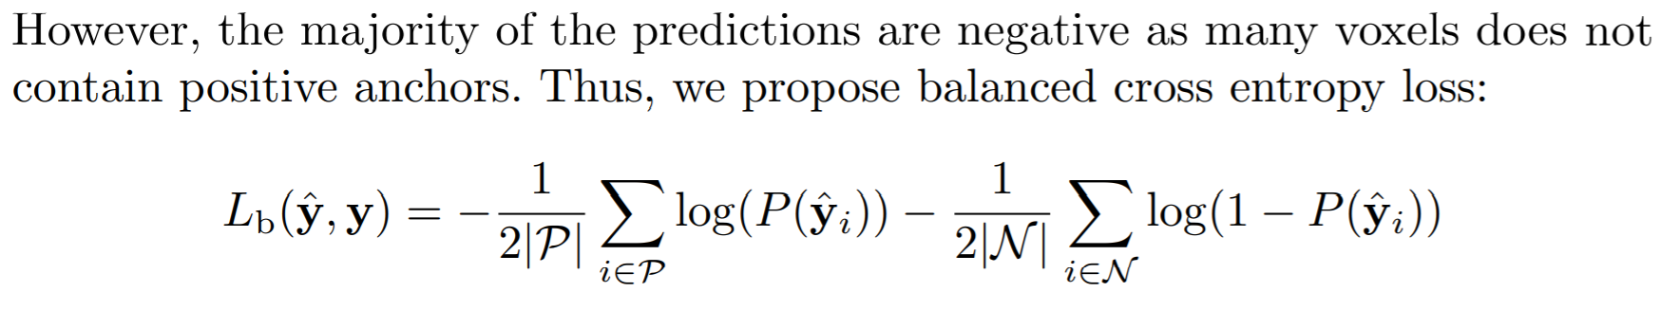
Multi-scale Bounding Box Anchor Prediction
For each k anchor box, the network predicts 1 object anchor likelihood score, 6 offsets relative to the anchor box, and c semantic class scores. This results in (c + 7)k outputs per voxel.
Specifically, for each anchor ratio seed ar, we use all unique permutations of as the aspect ratios of an anchor. In total, we use k = 13 anchors with including the identity ratio.
Losses
we define a sparsity to be positive if any of the subsequent positive anchor associated to the current voxel is positive.

Slide 7
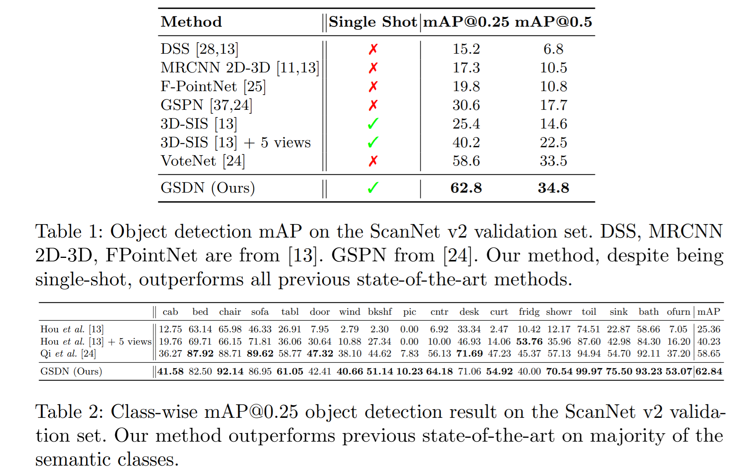

Slide 8
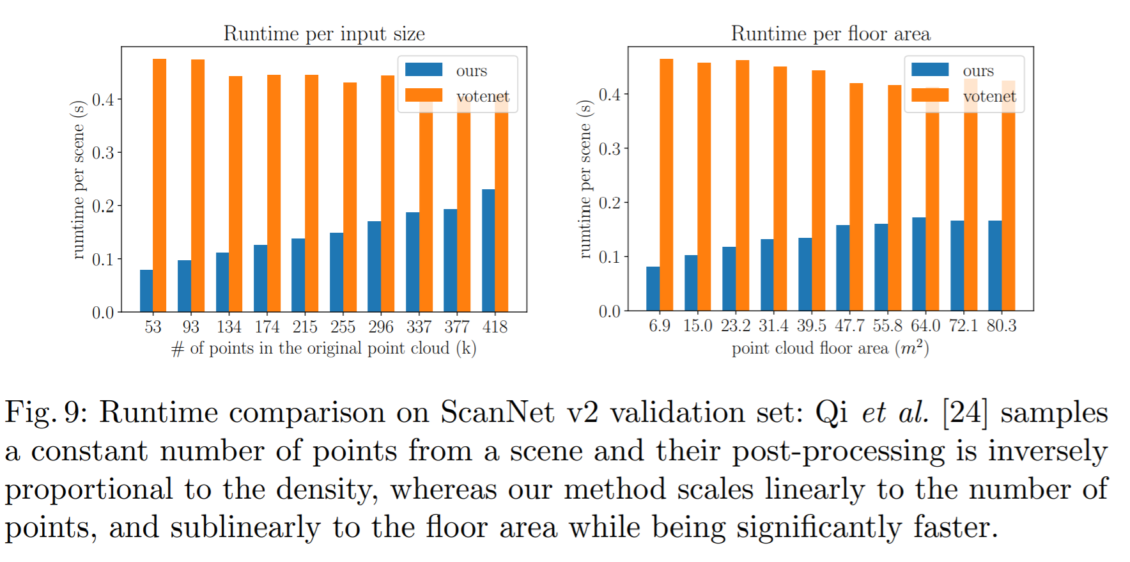

Slide 9
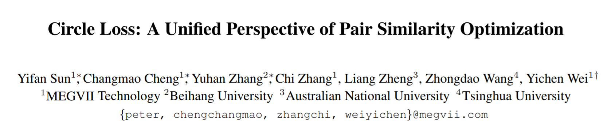

Slide 10
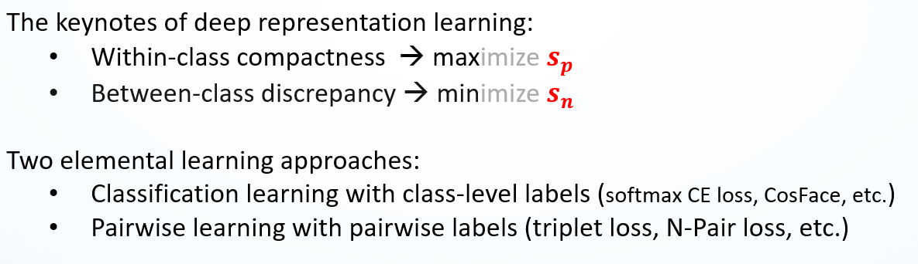
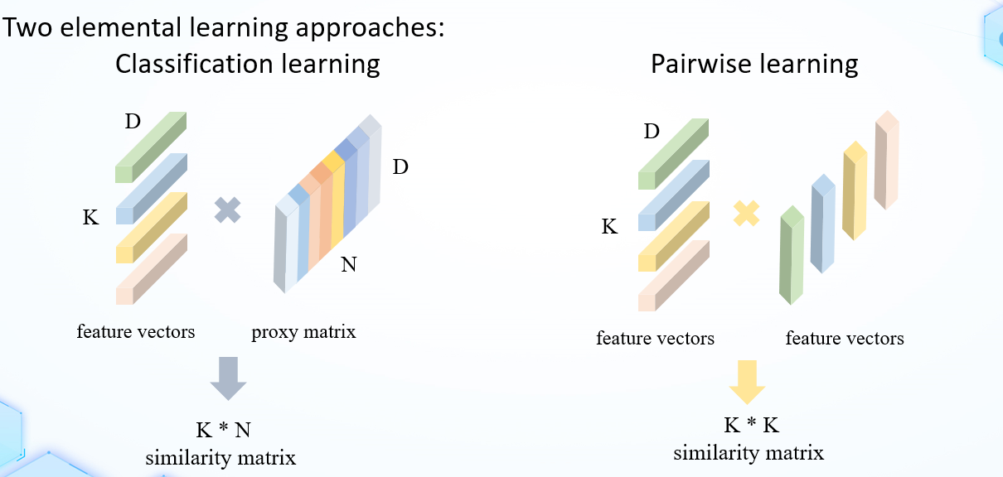

Slide 11
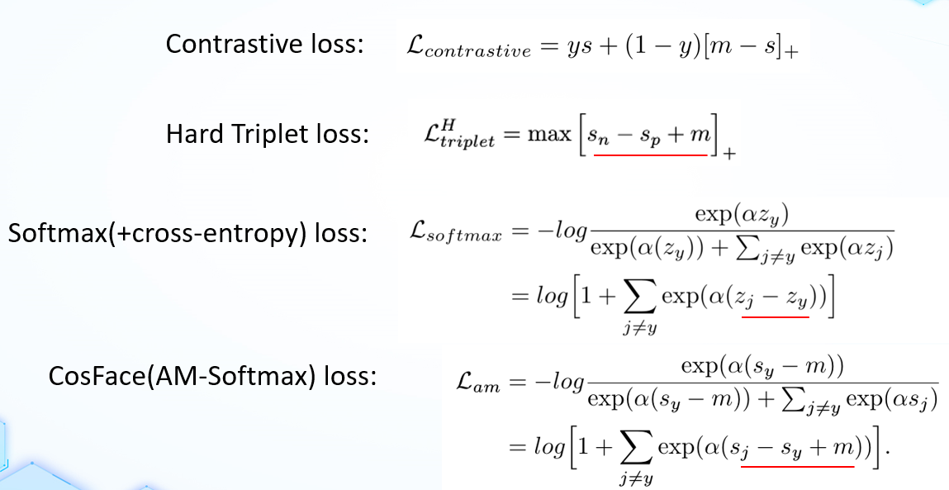

Slide 12
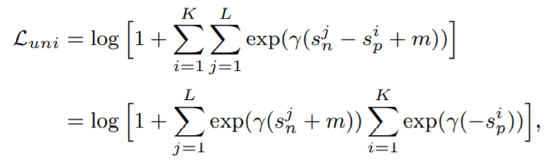
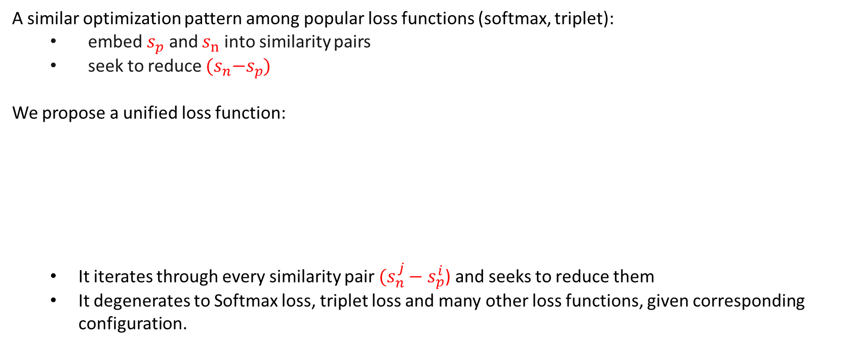
A Unified Perspective
A similar optimization pattern among popular loss functions (softmax, triplet):
embed $s_{p}$ and $s_{n}$ into similarity pairs
seek to reduce ${(s}_{n}−s_{p}$)
We propose a unified loss function:
It iterates through every similarity pair $(s_{n}^{j}−s_{p}^{i}$) and seeks to reduce them
It degenerates to Softmax loss, triplet loss and many other loss functions, given corresponding configuration.

Slide 13
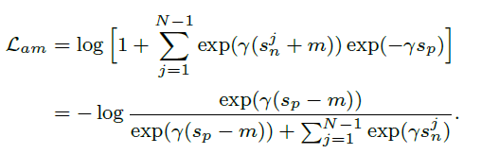
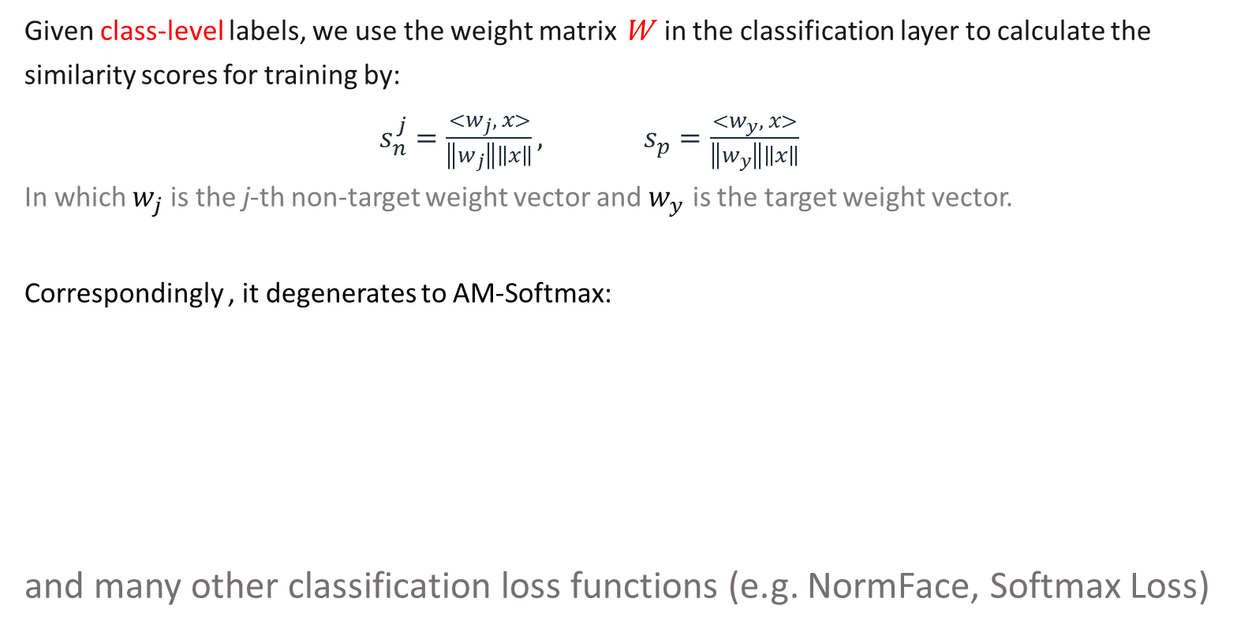
A Unified Perspective
Given class-level labels, we use the weight matrix W in the classification layer to calculate the similarity scores for training by:
$s_{n}^{j}=\frac{<w_{j}, x>}{\left\|w_{j}\right\|\left\|x\right\|}, s_{p}=\frac{<w_{y}, x>}{\left\|w_{y}\right\|\left\|x\right\|}$
In which $w_{j}$ is the j-th non-target weight vector and $w_{y}$ is the target weight vector.
Correspondingly , it degenerates to AM-Softmax:
and many other classification loss functions (e.g. NormFace, Softmax Loss)

Slide 14
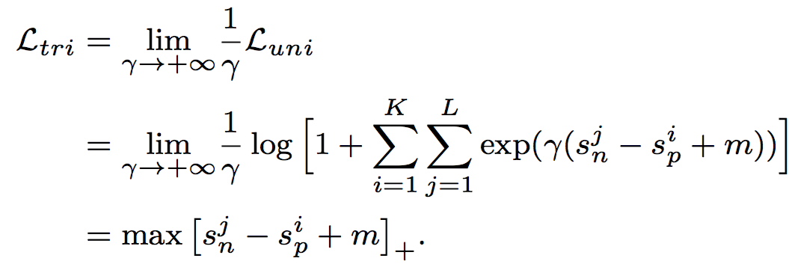
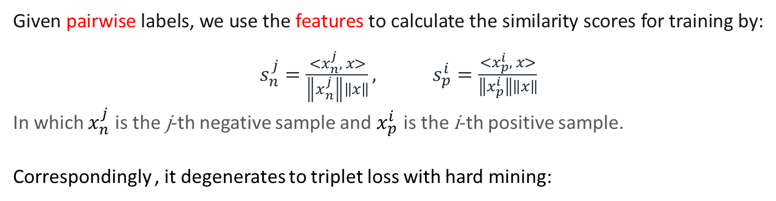
A Unified Perspective
Given pairwise labels, we use the features to calculate the similarity scores for training by:
$s_{n}^{j}=\frac{<x_{n}^{j}, x>}{\left\|x_{n}^{j}\right\|\left\|x\right\|}, s_{p}^{i}=\frac{<x_{p}^{i}, x>}{\left\|x_{p}^{i}\right\|\left\|x\right\|}$
In which $x_{n}^{j}$ is the j-th negative sample and $x_{p}^{i}$ is the i-th positive sample.
Correspondingly , it degenerates to triplet loss with hard mining:
Enlarging γ gradually reinforces the mining intensity and when γ → +∞, it results in the canonical hard mining

Slide 15
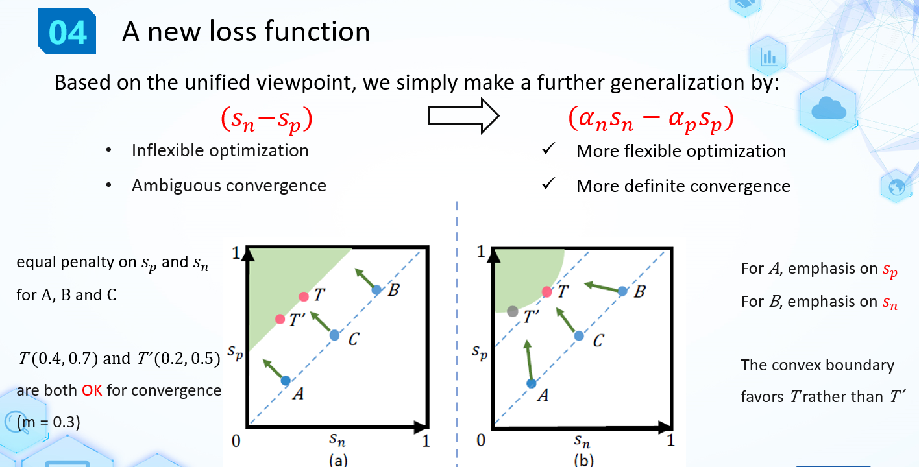

Slide 16
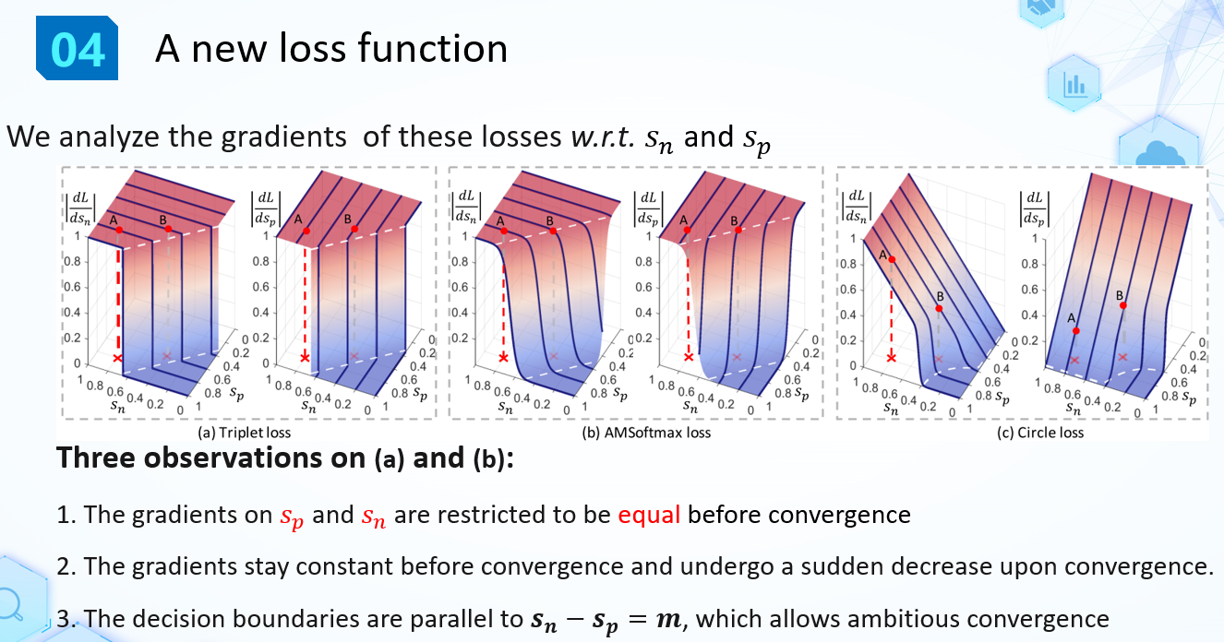

Slide 17
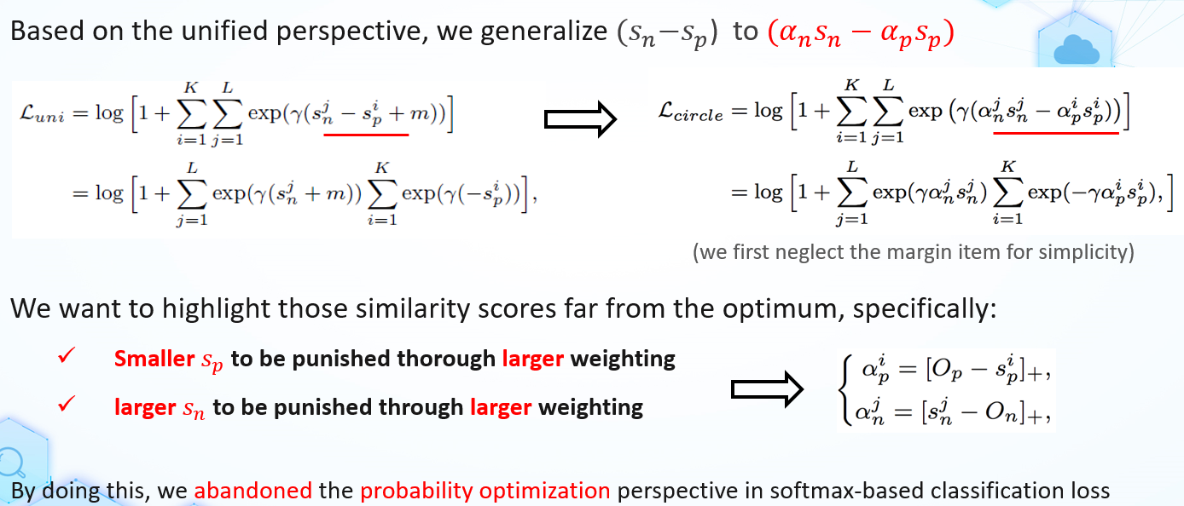

Slide 18
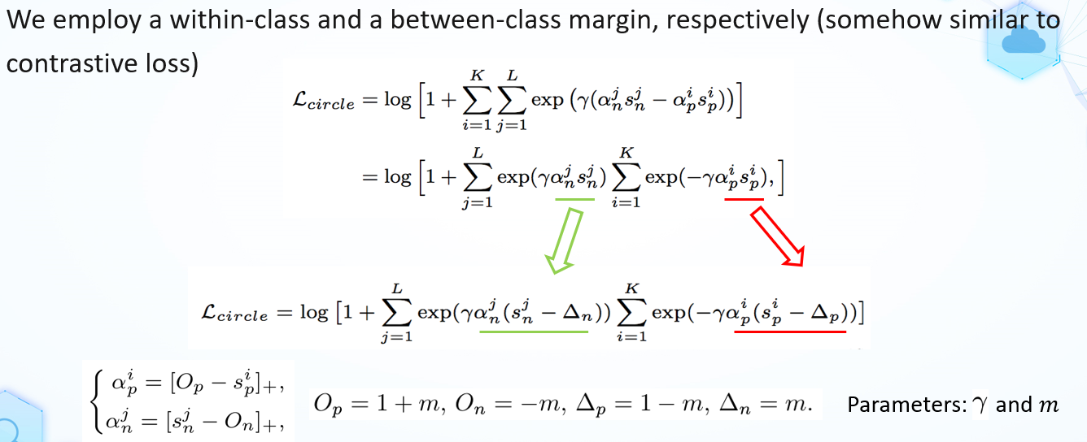

Slide 19
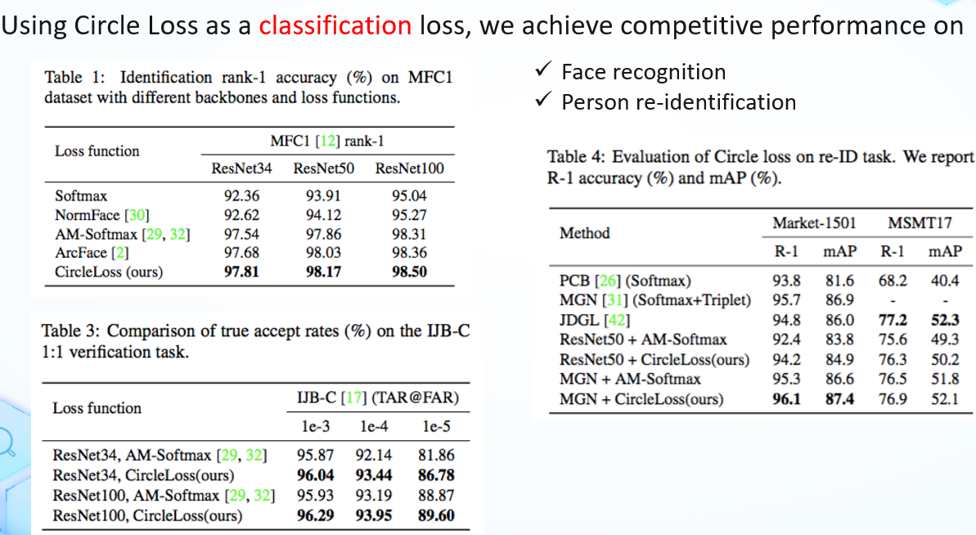

Slide 20
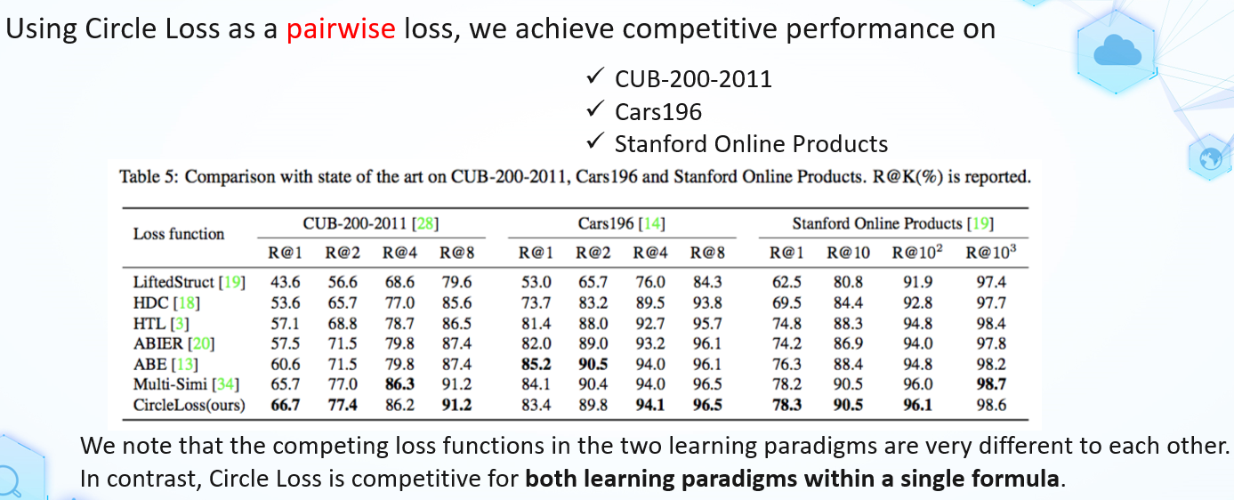

Slide 21
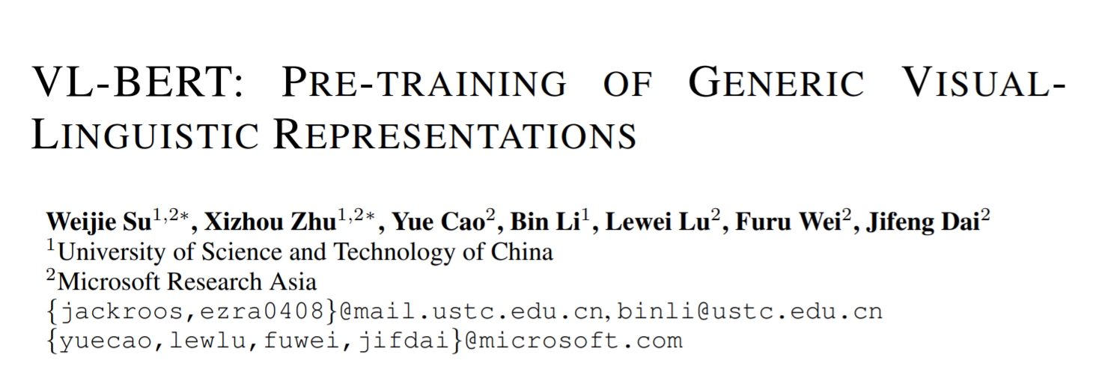

Slide 22
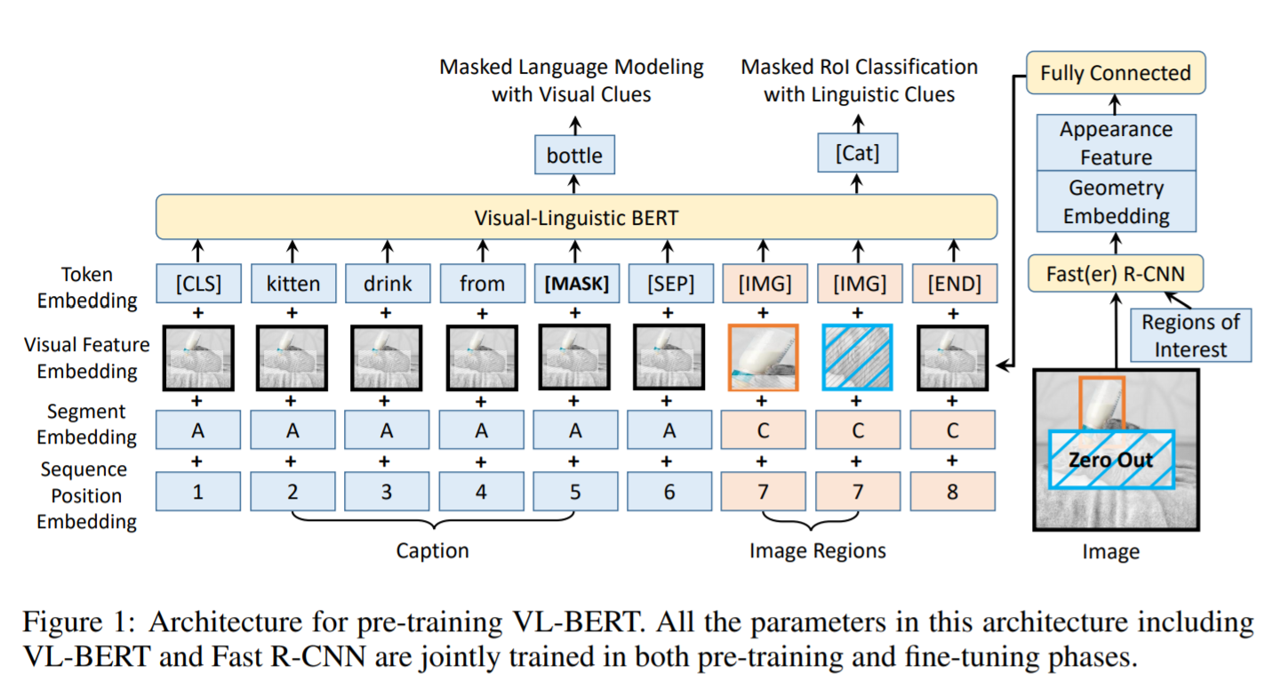

Slide 23
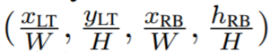
Token Embedding
Word: WordPiece embeddings with a 30,000 vocabulary, same as BERT
Visual elements: a special [IMG] token is assigned for each one of them
Visual Feature Embedding
visual appearance feature
For the visual element corresponding to an RoI, the visual appearance feature is extracted by applying a Fast R-CNN detector, where the feature vector prior to the output layer of each RoI is utilized as the visual feature embedding.
For the non-visual elements, the corresponding visual appearance features are of features extracted on the whole input image. They are obtained by applying Faster R-CNN on an RoI covering the whole input image.
visual geometry embedding
Each RoI is characterized by a 4-d vector, as , where (xLT, yLT) and (xRB, yRB) denote the coordinate of the top-left and bottom-right corner respectively, and W, H are of the width and height of the input image.

Slide 24
Segment Embedding
A and B for the words from the first and second input sentence respectively, and C for the RoIs from the input image. A learned segment embedding is added to every input element for indicating which segment it belongs to.
Sequence Position Embedding
A learnable sequence position embedding is added to every input element indicating its order in the input sequence, same as BERT. The sequence position embedding for all visual elements are the same.
Pre-training tasks
Task #1: Masked Language Modeling with Visual Clues.
The key difference is that visual clues are incorporated in VL-BERT for capturing the dependencies among visual and linguistic contents.
Task #2: Masked RoI Classification with Linguistic Clues
Each RoI in image is randomly masked out (with 15% probability), and the pre-training task is to predict the category label of the masked RoI from the other clues.
To avoid any visual clue leakage from the visual feature embedding of other elements, the pixels laid in the masked RoI are set as zeros before applying Fast R-CNN.

Slide 25
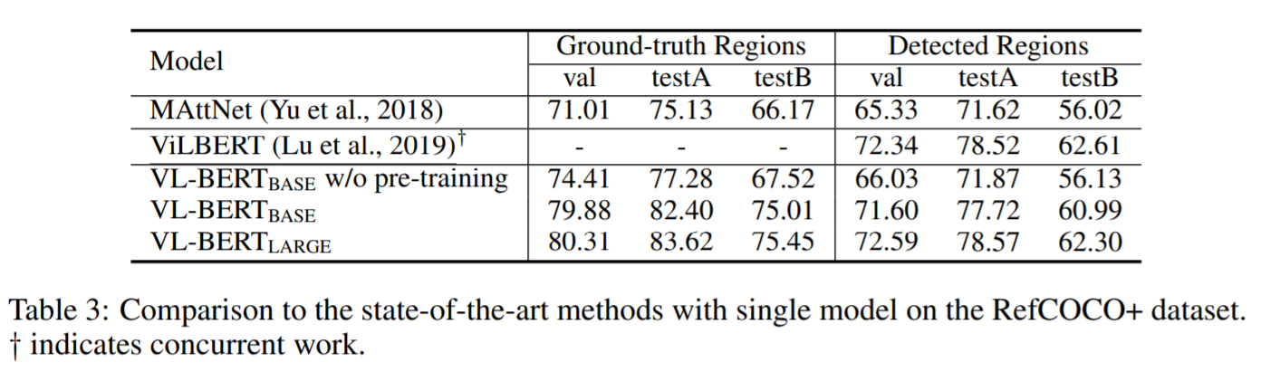
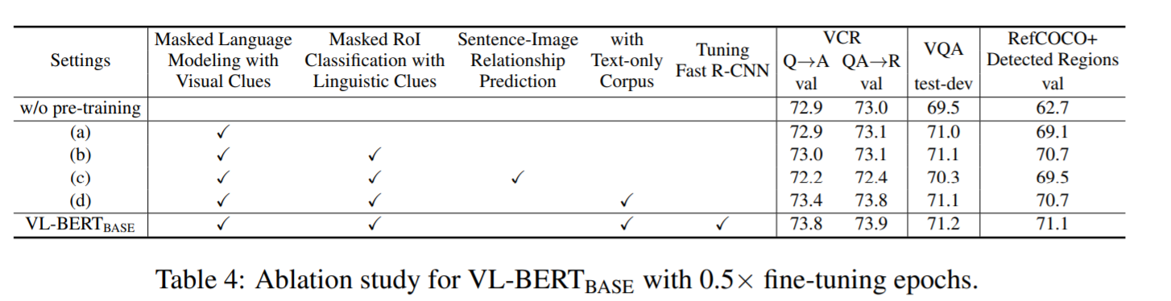

Slide 26
